Slide 1
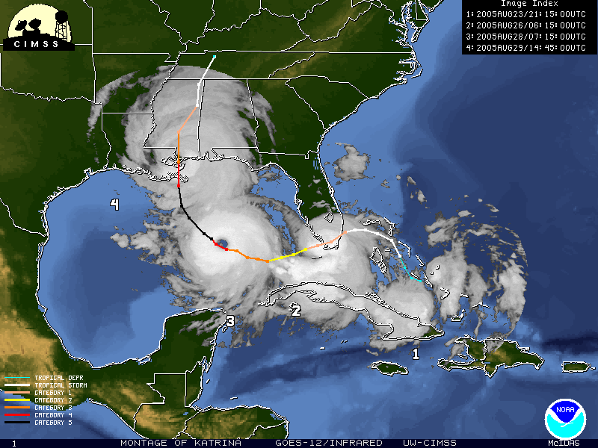
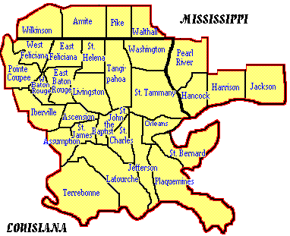
2016 Hurricane Season
National Weather Service
New Orleans/Baton Rouge Area www.srh.noaa.gov/lix

Slide 2
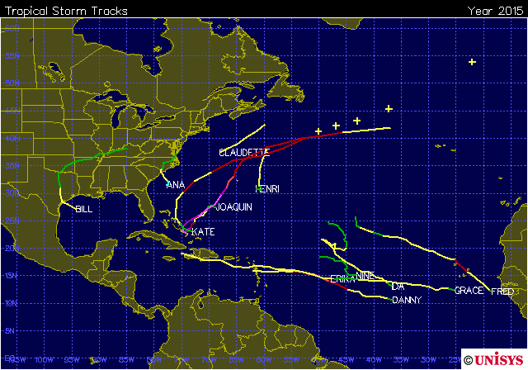
2015 Seasonal Recap
Near normal activity
12 Named Storms
4 Hurricanes
2 Major Hurricanes
Only 2 tropical storms impacted the continental US. No significant impact to Louisiana.

Slide 3
2016 Seasonal Outlook
NOAA Outlook is not issued until latter half of May
El Nino expected to keep Atlantic activity below normal
 | Average | Colo. State Released April 14 | NOAA (Released late May)
Named Storms | 12 | ?? | ??
Hurricanes | 6 | ?? | ??
Major Hurricanes | 2 | ?? | ??
Accumulated Cyclone Energy (ACE) | 92 | ?? | ??
*CAUTION* It only takes one storm to make a “bad” season

Slide 4
2016 Seasonal Outlook
NOAA outlook will be issued in latter half of May
Colorado State outlook will be issued in mid-April
Lots of factors influence seasonal activity. Two potential big players for this year:
La Nina?
Transitioning out of El Nino with a 50% chance of being in La Nina by this summer
Typically leads to above normal activity
Atlantic Multi-decadal Oscillation
Looks like low values could persist into Summer
Typically leads to below normal activity
Other factors: Amount of dry air coming off of Africa, wind shear, etc

Slide 5
Seasonal Outlook Limitations
We do not have enough skill to give any indication of when or even IF any storms will impact land as part of the outlook
Forecast of an inactive season can lead to a false sense of security. It only takes one storm to make it a “bad” season.
Bottom line: Prepare anyway!

Slide 6
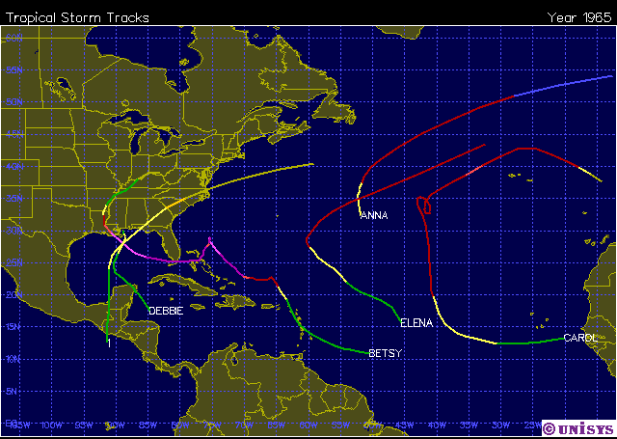
1965: Inactive Season
High Impact for FL/LA
Well below normal activity
6 Named Storms
5 Hurricanes
1 Major Hurricane
Betsy caused significant impacts across FL and LA

Slide 7
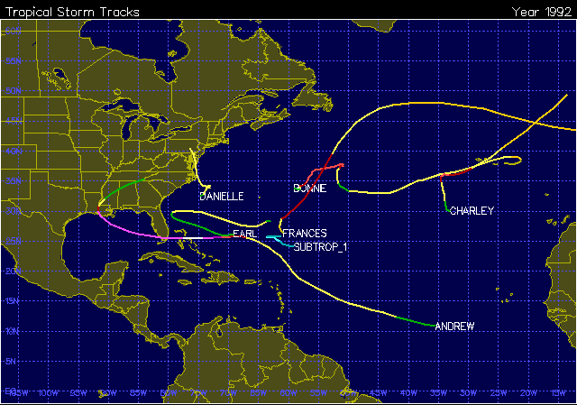
1992: Inactive Season
High Impact for FL/LA
Neutral El Niño
Well below normal activity
7 Named Storms
4 Hurricanes
1 Major Hurricane
Andrew caused significant impacts across FL and LA

Slide 8
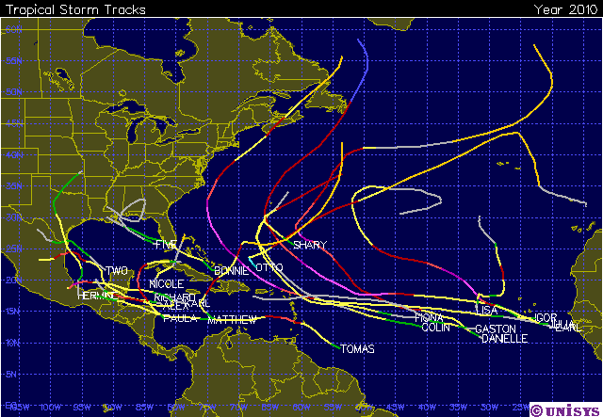
2010: Active Season
Minimal Impact for LA/MS
19 Named Storms
7 Tropical Storms
12 Hurricanes
5 Major Hurricanes
Minimal impact across LA/MS caused by weak tropical depressions

Slide 9
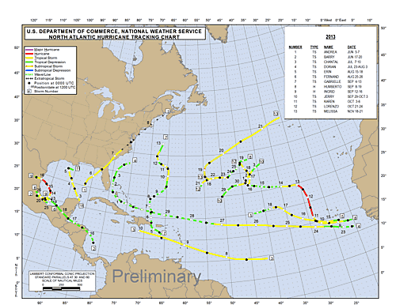
Seasonal Forecasts Can Be Wrong
2013 forecast:
13-20 named storms
7-11 hurricanes
3-6 major hurricanes
2013 reality:
13 named storms
2 hurricanes
0 major hurricanes

Slide 10
What’s New or Enhanced for this year?

Slide 11
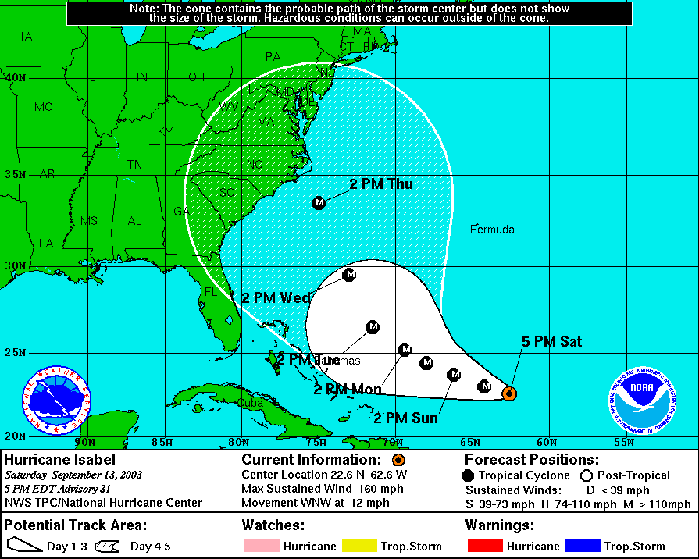
Forecast Cone Gets Smaller Every Year
2003 Cone
Current Cone

Slide 12
Forecast Cone Gets Smaller Every Year
Cone is created by connecting circles that represent 2/3 of the average error over the past 5 years at each forecast time step
Since the cone represents 2/3 of the average error, this means 1/3 of the time, storms are *expected* to track outside the cone (more likely in recurving storms at higher latitudes)
Forecast Period (hours) | 2015 circle Radius Atlantic Basin (nautical mile) | 2015 circle Radius Atlantic Basin (nautical mile)
12 | 32 | 30
24 | 52 | 49
36 | 71 | 66
48 | 90 | 84
72 | 122 | 115
96 | 170 | 165
120 | 225 | 237

Slide 13
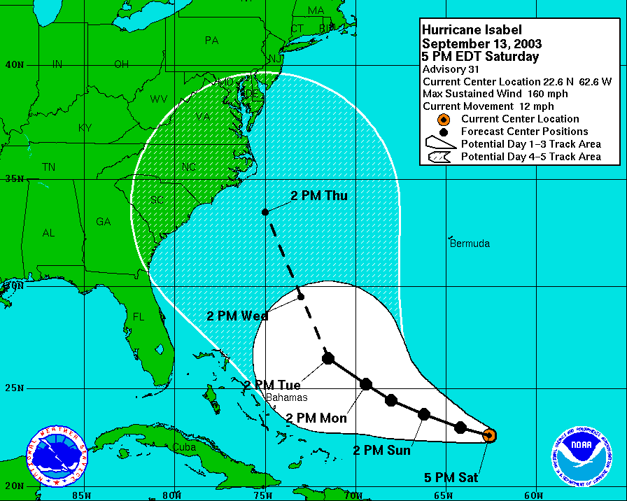

Slide 14
Forecast cone is not an “impact cone”
The cone is only a representation of the most likely path the CENTER of a storm will take.
Impacts can extend well beyond the cone, especially for large storms.
At left, Hurricane Ike remained well south of the LA coast, and southeast LA was never in the cone, but storm surge from Ike exceeded that of Gustav in some places.

Slide 15
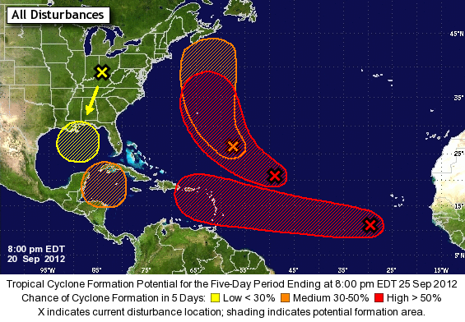
5 Day Tropical Weather Outlook
What Does It Mean?
X indicates location of current disturbance
Color is determined by the probability of development over the next 5 days
The shaded areas indicate the general areas in which development could occur over the next 5 days – can be used to infer a VERY generalized track.

Slide 16
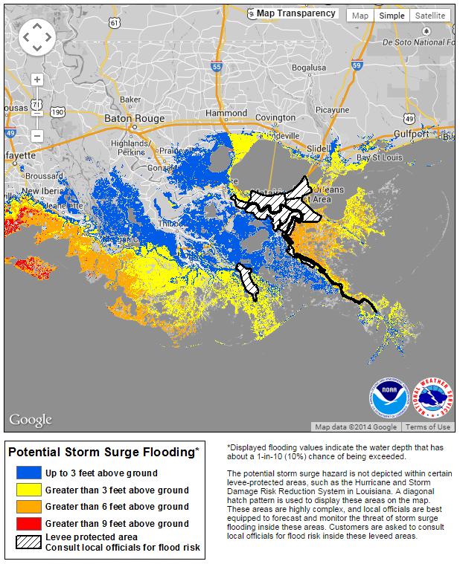
Potential Storm Surge Inundation Graphic
Becoming “operational” for the 2016 season
Will be available roughly 48 hours before arrival of tropical storm force winds (basically once watches are issued)
“Reasonable” worst case scenario based on current NHC forecast.
Potential flood levels are is given in feet above ground, based on current forecast
Can change slightly from forecast to forecast, so do not interpret the colors as hard set boundaries

Slide 17
Experimental Storm Surge Watch/Warning
Still “experimental” for this season.
Watch timeline: Issued 48 hours before possibility of life-threatening surge, or other hazards that would hinder evacuations.
Warning timeline:
Issued 36 hours before possibility of life-threatening surge, or other hazards that would hinder evacuations
Is a result of collaboration between NHC and local offices.
Issued for areas where “life threatening” inundation is possible (greater than 3 ft).

Slide 18
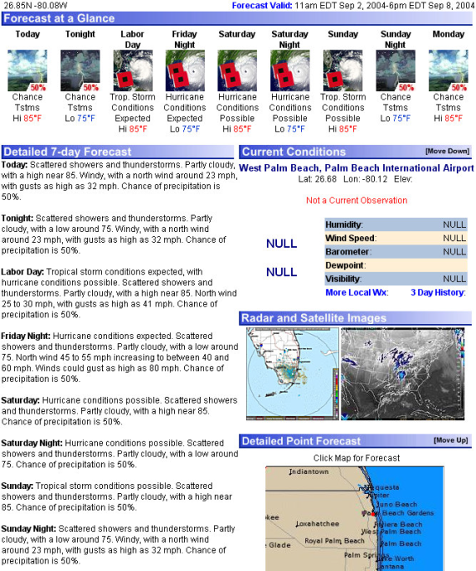
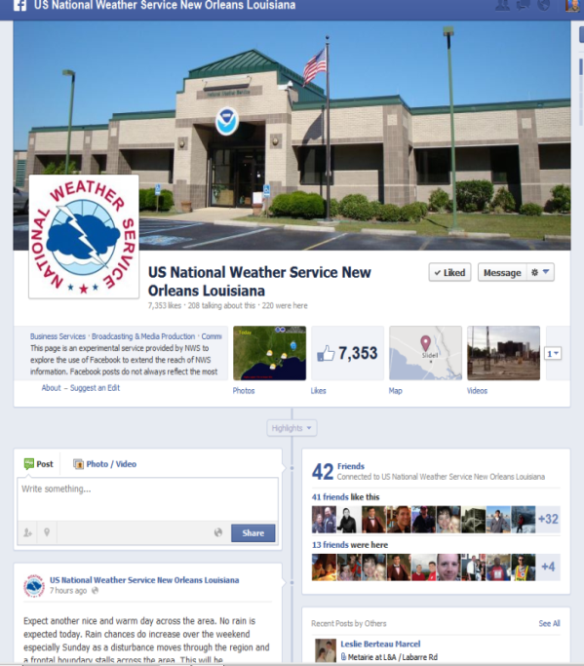
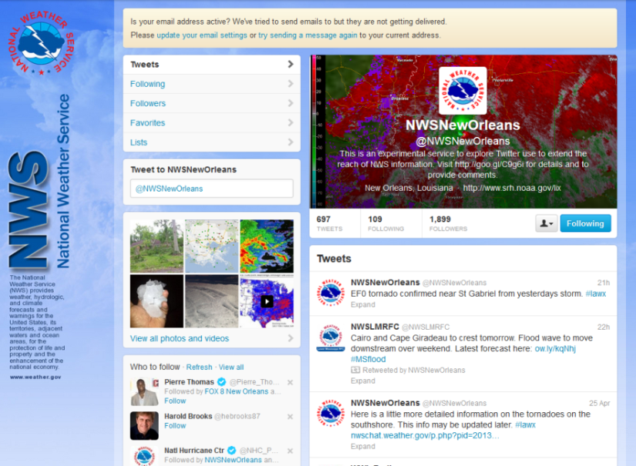
Stronger Social Media Presence
Website: www.weather.gov/neworleans
Twitter: @NWSNewOrleans
Facebook: NWSNewOrleans

Slide 19
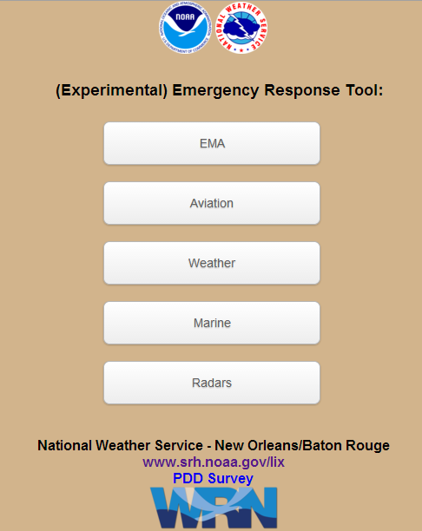
Mobile Emergency Response Tool
Basically a webpage optimized for use on mobile devices
Gives access to a multitude of weather outlooks and products in an easy to use interface
Most useful information for hazardous weather is accessed via the “EMA” button
innovation.srh.noaa.gov/ertool

Slide 20
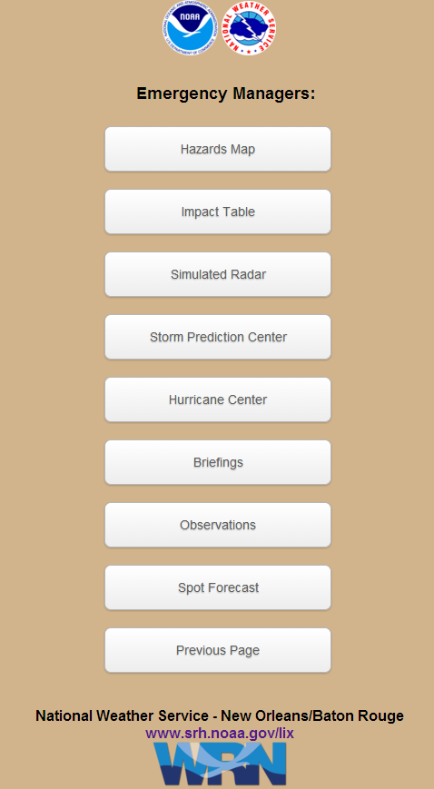
Mobile Emergency Response Tool
“EMA” Button will provide most useful information for hazardous weather
Severe weather outlooks accessed via the “Storm Prediction Center” button
Tropical cyclone forecasts and outlooks accessed via the “hurricane center” button
Most recent weather briefings from our office accessible via the “briefings” button (pdf files should load quickly due to small file size)

Slide 21
NWS New Orleans
Contact Info
Websites www.weather.gov/neworleans (main page)
www.weather.gov/neworleans/?n=embrief2 (briefings)
Telephone
985-649-0429 x4 504-522-7330 x4

