Slide 1
Zika Update
February 2016

Slide 2
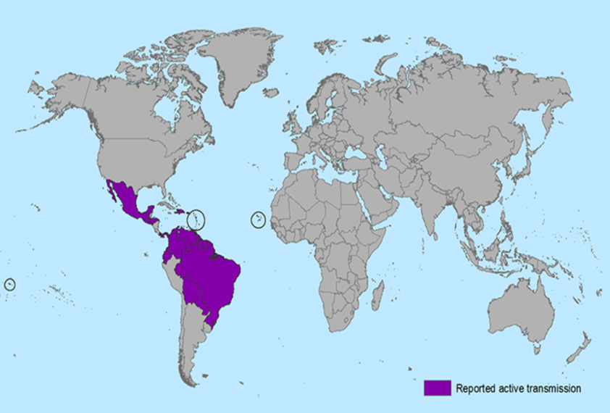
Zika-Affected Areas
Prior to 2015, Zika virus outbreaks in Africa, Southeast Asia, & Pacific Islands
In May 2015, first confirmed Zika virus infections in Brazil
No locally transmitted cases in continental U.S.,
but cases reported in returning travelers
As of January 22, 2016, local transmission had been identified in at least 20 countries or territories in the Americas, including Puerto Rico

Slide 3
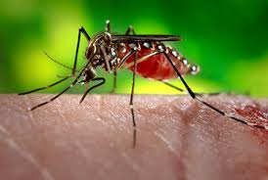
Current Situation
February 1, 2016: World Health Organization declares Zika an International Public Health Emergency
With recent outbreaks, the number of Zika cases among travelers visiting or returning to the United States will likely increase.
These imported cases could result in local spread of the virus in some areas of the United States.
There are NO current cases yet reported in Louisiana
Zika virus will likely continue to spread and it is difficult to determine how the virus will spread over time.
Mosquitoes capable of carrying Zika virus are found in Louisiana

Slide 4
Zika Virus: Transmission
Transmitted to people through the bite of an infected Aedes species mosquito
Mosquitoes lay eggs in and near standing water
They are aggressive daytime biters. Live near and prefer to bite humans
Mosquitoes become infected when they feed on a person already infected with the virus
Infected mosquitoes can then spread the virus to other people through bites
Spread of the virus through blood transfusion and sexual contact have been reported

Slide 5
Zika Virus: Mosquito Distribution

Slide 6
Zika Virus: Symptoms About one in five people infected with Zika Virus become symptomatic
Majority of persons infected with Zika Virus are asymptomatic
Clinical illness usually mild, lasting several days to a week
Characteristic findings include sudden onset of fever, red flat rash, joint pain, and red itchy eyes
Major risk is to the developing fetus of pregnant women, causing miscarriage and birth defects (microcephaly)

Slide 7
Zika Virus: Diagnosis
Travel from an affected area AND sudden onset of fever, red flat rash, joint pain, with red itchy eyes
A lab test (RT-PCR) should be performed on serum specimens collected within the first week of illness
Substantial serological cross-reactivity with other similar viral infections
No commercially available test for Zika Virus
Testing performed at CDC Arbovirus Diagnosis Laboratory

Slide 8
Zika Virus: Treatment
No specific antiviral treatment is available – generally supportive treatment
Supportive care: rest, fluids, and use of pain relievers and fever reducers
Avoid Aspirin and other non-steroidal anti-inflammatory drugs (NSAIDs) until Dengue can be ruled out
In particular, pregnant women who have a fever should be treated with acetaminophen (Tylenol)
IMPORTANT!!! Protect from further mosquito exposure during the first few days of illness to reduce further transmission!!

Slide 9
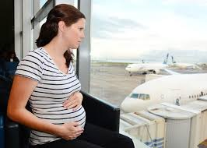
Zika Virus: Travel Advisory
As of February 2016, CDC advises:
All travelers should take steps to avoid mosquito bites to prevent Zika virus infection and other mosquito-borne diseases
Pregnant women should consider postponing travel to any area where Zika transmission is ongoing
Healthcare providers are encouraged to report suspect Zika virus cases to Louisiana Office of Public Health at 800-256-2748

Slide 10
Zika Virus: Returned Travelers

Slide 11
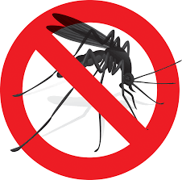
Zika Virus: Prevention
There is no vaccine or preventive drug available
Avoid mosquito bites
Use air conditioning or window and door screens when indoors
Wear long sleeves and pants, and use mosquito repellents when outdoors

Slide 12
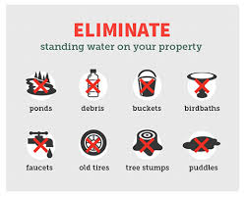
Preparedness at the Parish Level
Vector Surveillance and Control
Before mosquito season:
Conduct public mosquito education campaigns to focus on reducing or eliminating larval habitats
Conduct surveys to determine abundance, distribution, and type of containers (large numbers of containers may translate to high risk)
Initiate community wide source reduction campaign
Cover, dump, modify or treat large water-holding containers with long-lasting larvicide

Slide 13
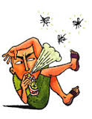
Preparedness at the Parish Level
Vector Surveillance and Control
Beginning of mosquito season:
Continue public education campaigns
Develop and distribute mosquito education materials and personal protection measures
Initiate community wide surveys to determine presence/absence, estimate relative abundance, determine distribution, develop detailed vector distribution maps
Continue community source reduction efforts
Initiate preventive control to reduce mosquito populations

Slide 14
Preparedness at the Parish Level
Vector Surveillance and Control
Single or several suspected/confirmed imported/locally acquired cases:
Continue public mosquito containment education campaigns
Treat with long-lasting larvicide any water-holding containers that cannot be dumped, covered, discarded or otherwise modified
Eliminate larval habitats within 100-200 yards/meters around a case’s home
Educate the public about reported cases of disease and urge them to use insect repellents, window/door screens, and air conditioning

Slide 15
Preparedness at the Parish Level
Vector Surveillance and Control
Outbreak; clusters or suspected or confirmed cases:
Divide the outbreak area into operational management areas where control measures can be effectively applied to all buildings and public area within a few days
Conduct door-to-door inspections & mosquito control in an area-wide fashion
Identify and treat, modify, or remove mosquito-producing containers
Organize area/community clean-up campaigns targeting disposable containers
Combine outdoor spatial or residual spraying with source reduction and larviciding

Slide 16
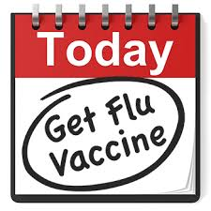
Preparedness at the Parish Level
Influenza Prevention
Influenza prevention campaign will reduce flu cases to reduce misdiagnosis of Zika vs. Influenza
Flu Season is starting to really pick up now, with serious cases
Public education campaigns to promote influenza vaccination
Influenza symptoms can mirror those of Zika, by getting vaccinated you reduce the risk of misdiagnosis

Slide 17
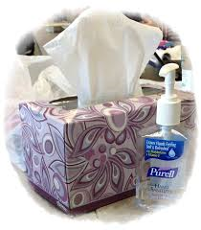
Preparedness at the Parish Level
Social Distancing
Social distancing keeps us safe from many infections, simple rules!
Social distancing helps prevent spread of many viruses
Stay home if you are sick!
Wash hands frequently
Teach & remind community regarding respiratory etiquette such as covering sneezes and coughs, use and discarding of tissues
Make tissues and hand sanitizers readily available to the public
Disinfect frequently touches surfaces (doorknobs, phone)

Slide 18
Preparedness at the Parish Level
Participation in Health Preparedness – Points of Dispensing
Not yet appropriate for Zika, as there is no medication or vaccination, however participation with the health system promotes partnerships and planning
Points of Dispensing (PODS) are used to quickly and accurately dispense medications, vaccines, or medical assets (PPE) to a large number of people, building on community and healthcare partnerships

Slide 19
Preparedness at the Parish Level
Participation in Health Community Preparedness –Points of Dispensing
Requires each parish to develop a Planning Team which should be represented by Emergency Management, Law Enforcement, Public Health, and other partners.
Planning team should assess the parish as a whole and determine the needs of the population and resources the parish has to address those needs
Engage community businesses, universities, organizations, etc
POD Toolkits are available from Center for Community Preparedness and Regional Public Health offices

Slide 20
Zika Update
Conclusion
OPH will continue to monitor the situation and provide updates
Start preparing now
Understand Zika, it’s transmission and prevention
Prepare your community to reduce mosquito populations
Encourage flu shots!
Participate in health related community preparedness

